Slide 1

Linear Time-invariant Systems and Impulses + intro to convolution
SIGNALS AND SYSTEMS
Week 3

Slide 2
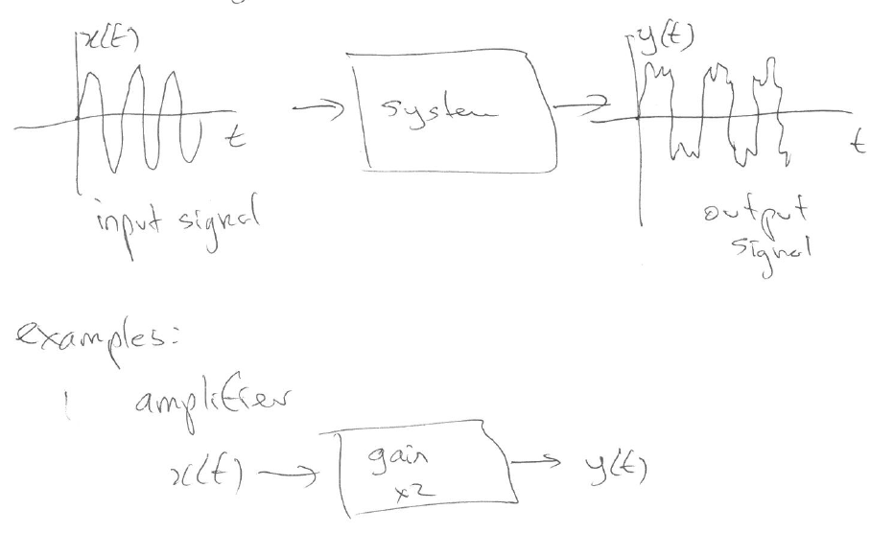
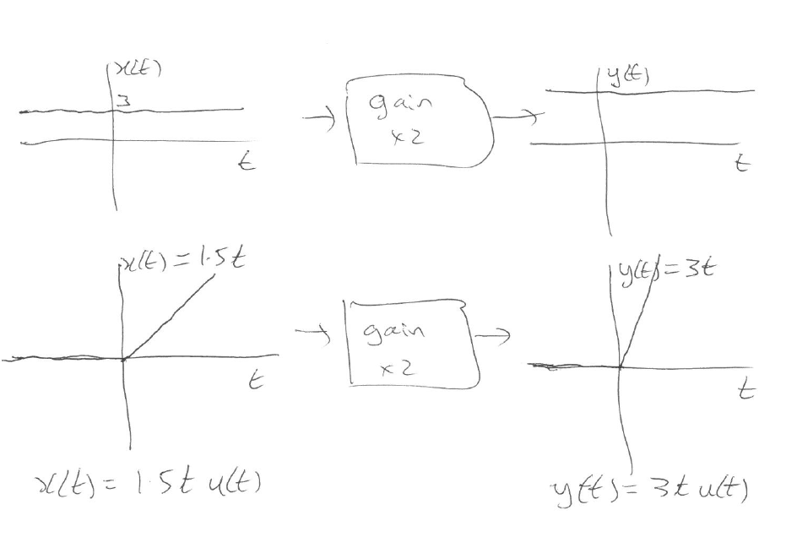
Signals and Systems
1. Gain

Slide 3
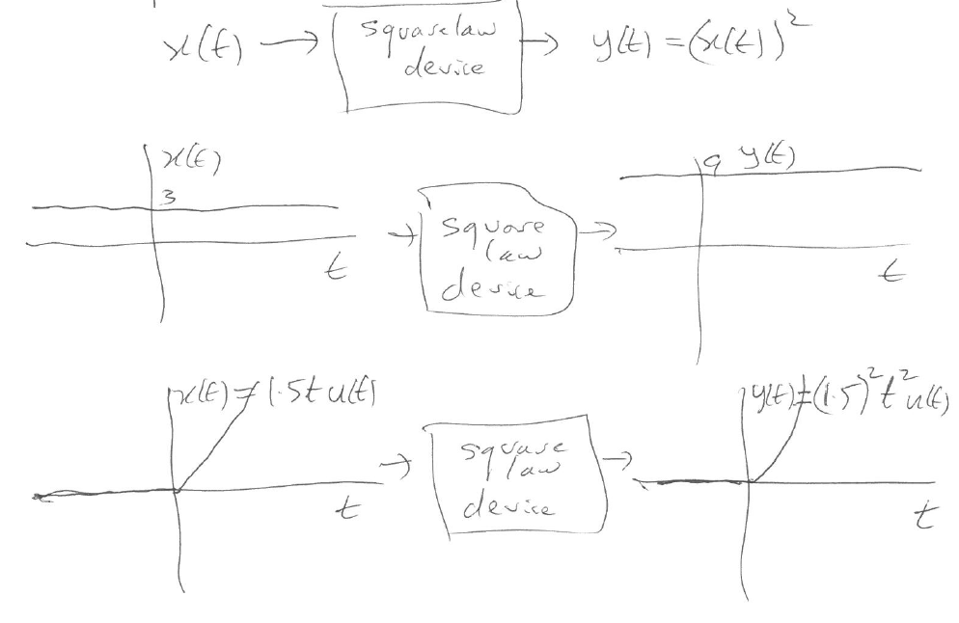
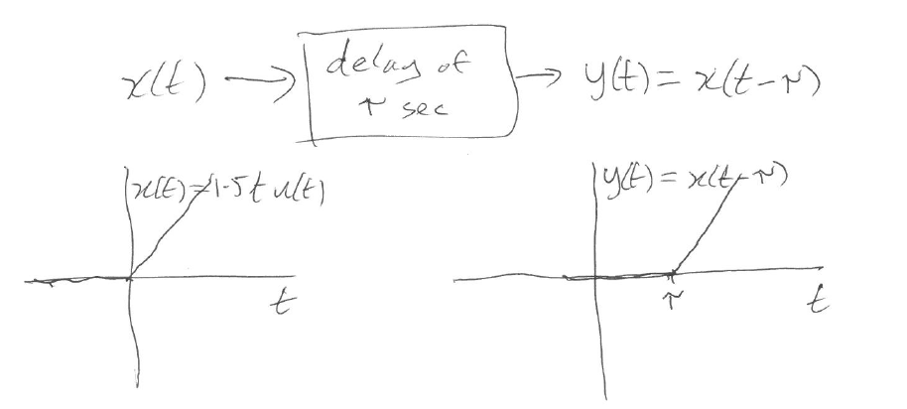
2. Square law device
3. Delay

Slide 4
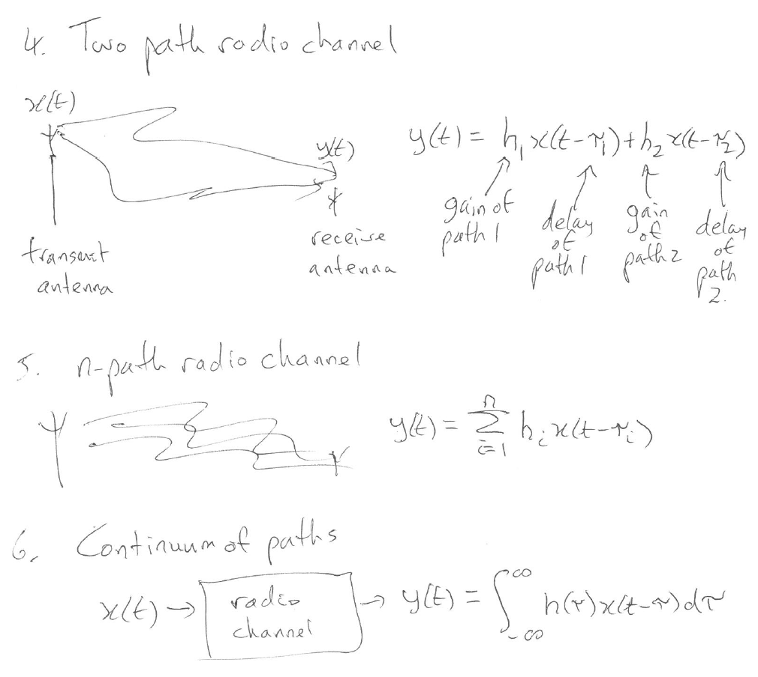

Slide 5
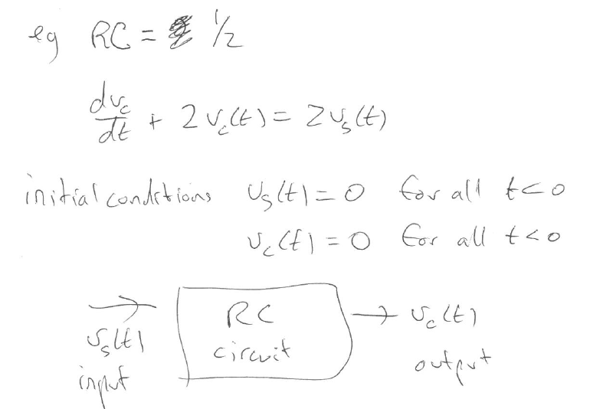
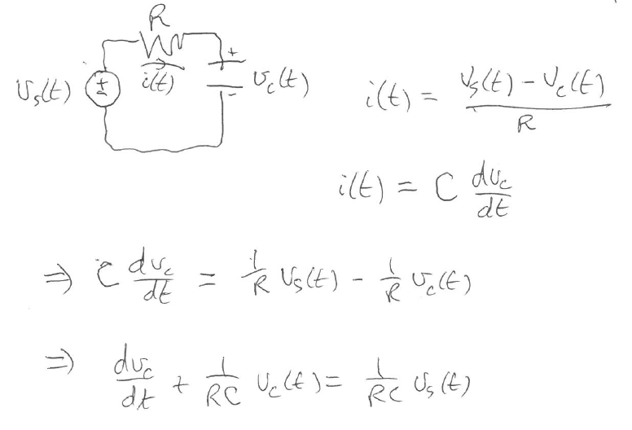

7. Electrical Circuit

Slide 6
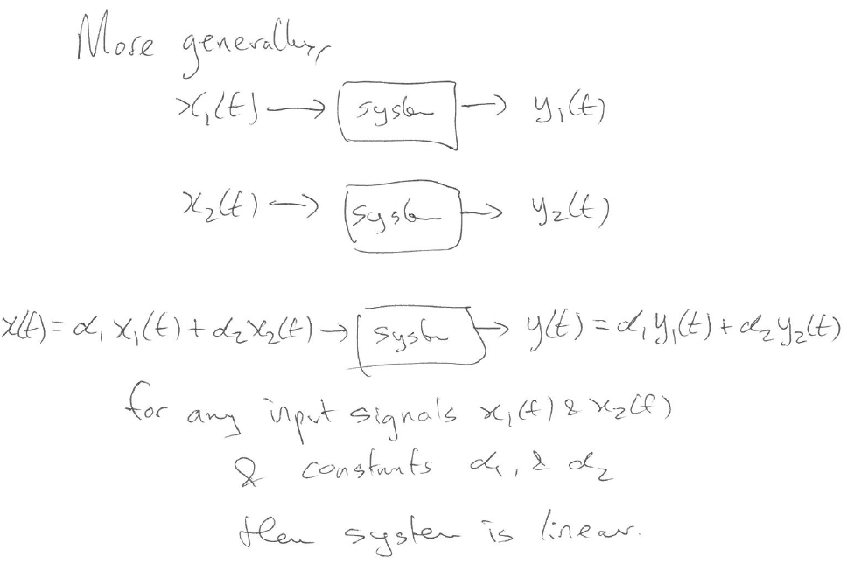
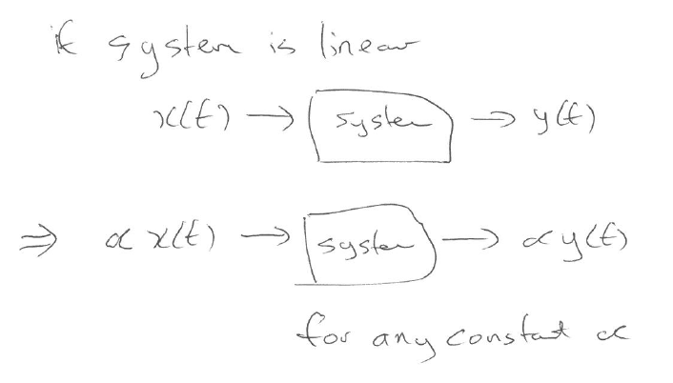
Linear Systems

Slide 7
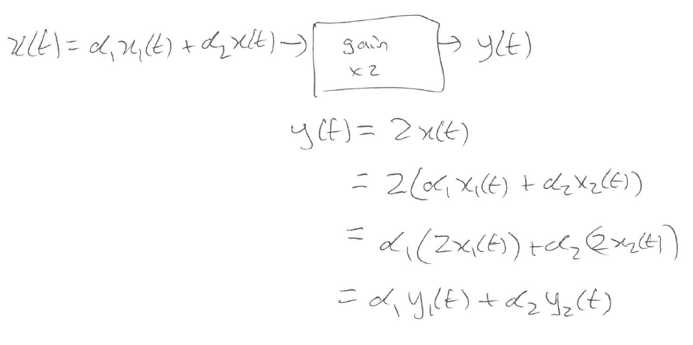
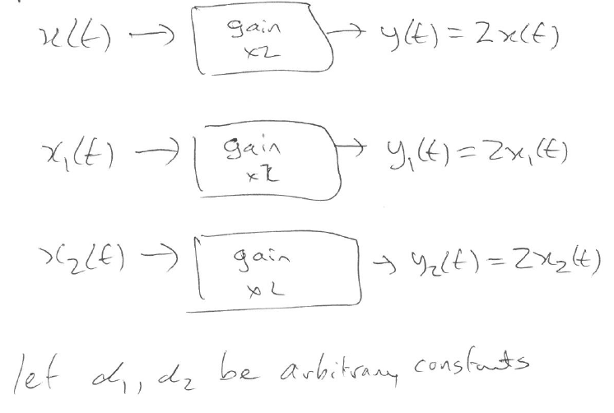
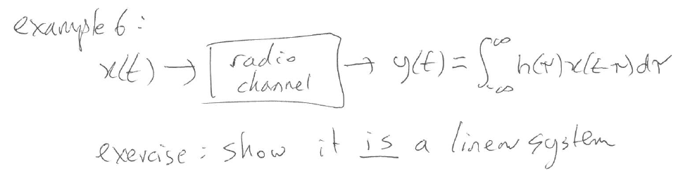
Examples: 1. Amplifier
So amplifier system is linear

Slide 8
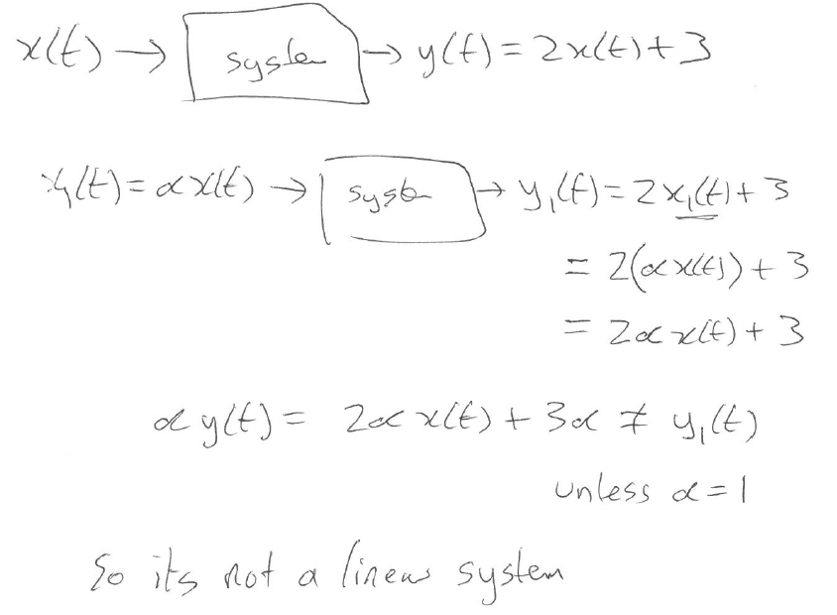
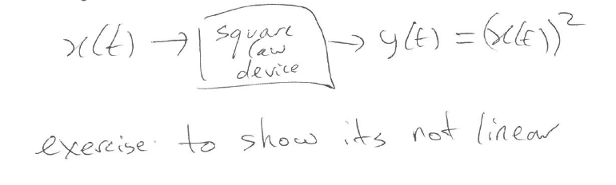
Non-examples:
1. Affine System
2. Square law device

Slide 9
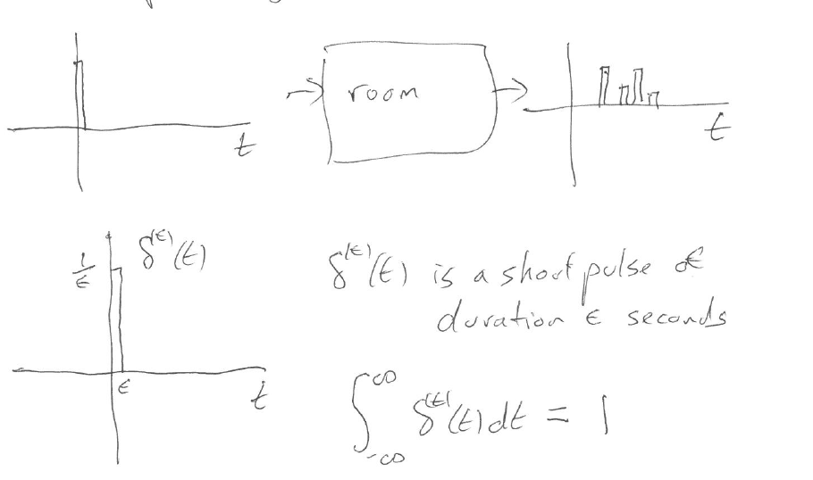
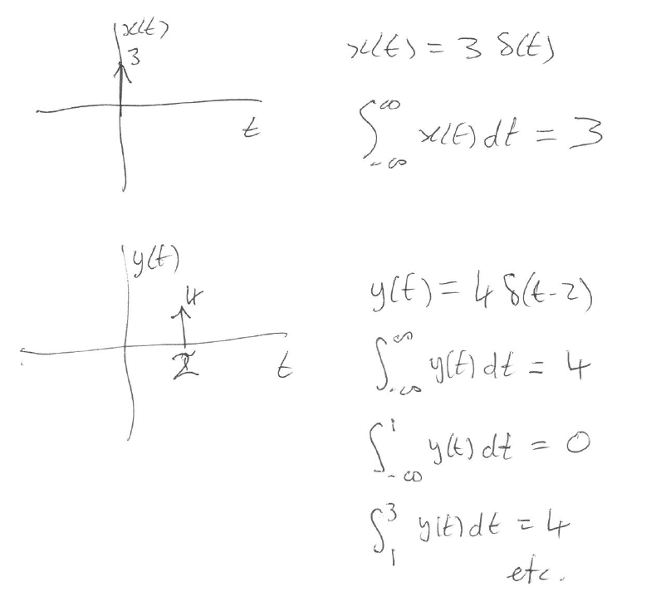
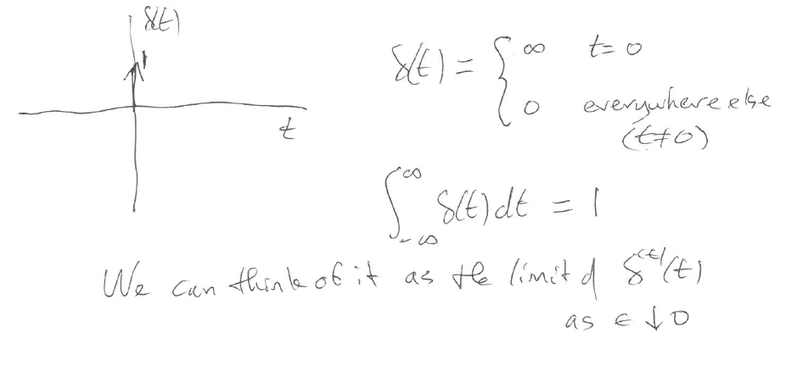
Unit impulse signal
Magnitude of impulse and integration

Slide 10
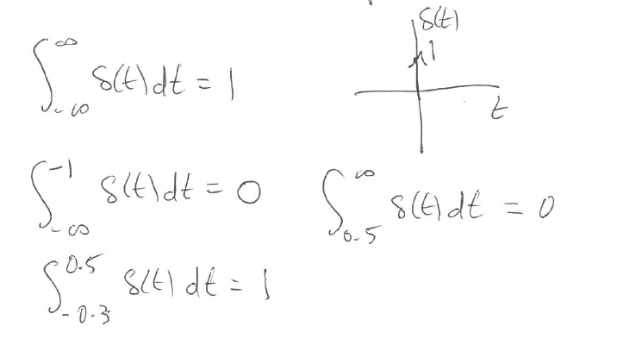
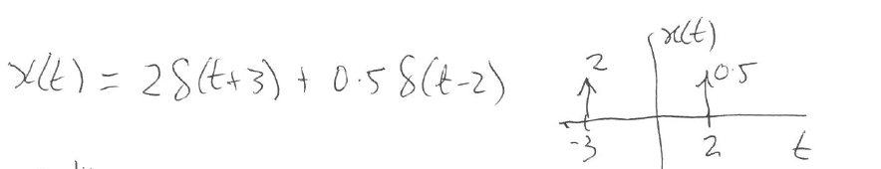
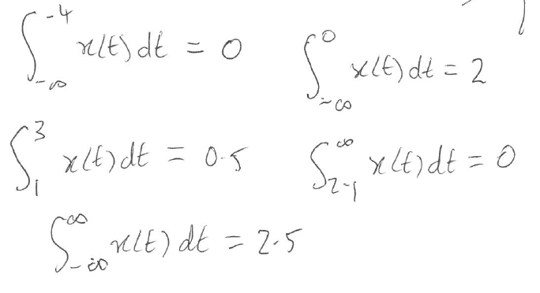
Integration Properties of signals made up of Impulses (ie of delta functions)
We now want to recall some integration properties of the unit δ-function:
Here is a signal with two delta functions:
We can also integrate this signal, x(t), over different intervals
The rule is to add up the magnitudes of the impulses that lie in the range of integration.

Slide 11

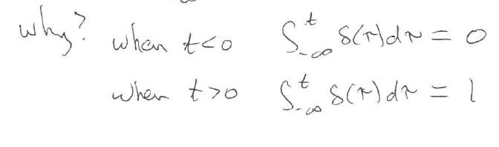
Since we are looking at integrating the unit impulse signal, there is a simple connection between the unit impulse signal and the unit step function, which is obtained by integration:

Slide 12
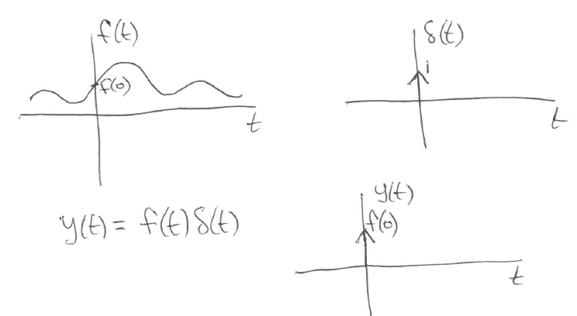
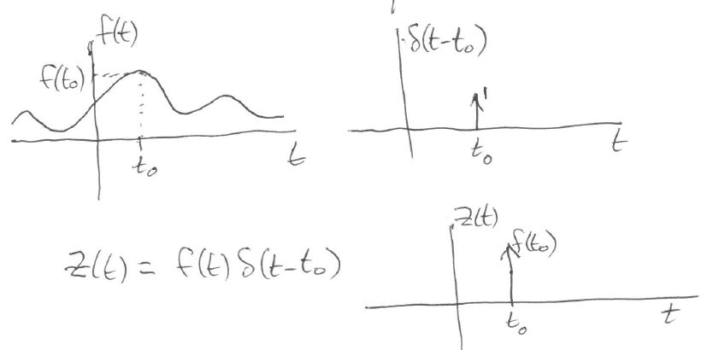
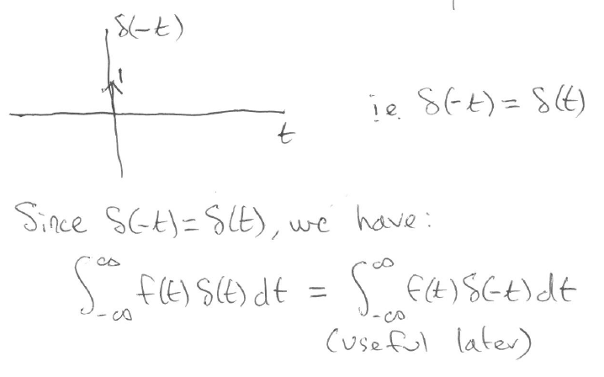

Some other Properties of unit impulses
What happens if we multiply a signal by $δ\left(t\right)?$
What happens if we multiply a signal by $δ\left(t−t_{0}\right)?$
What does $δ\left(−t\right) look like ?$

Slide 13
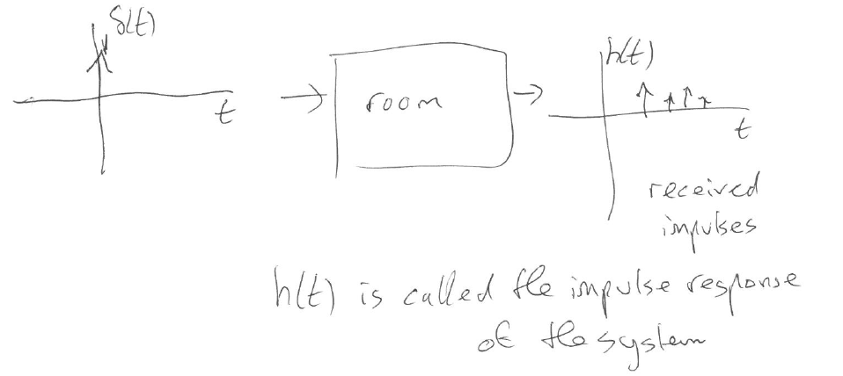
Impulse response of a system

Slide 14
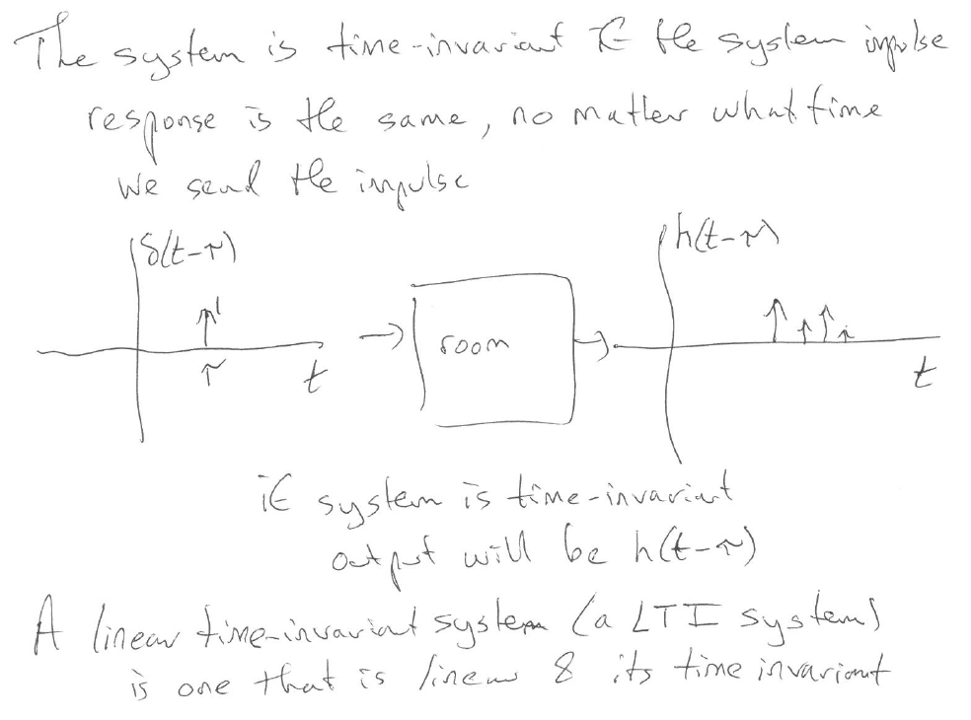
Time invariant system

Slide 15
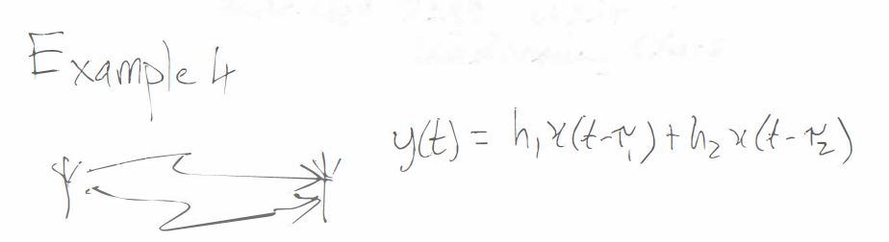
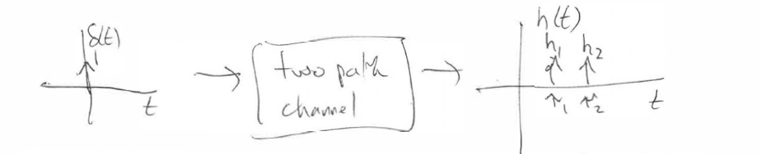
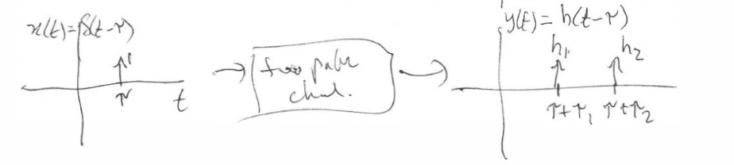
This focus from now on is on Linear, Time-invariant Systems. We call such systems LTI systems for short.
Recall the two path radio channel example:
We want to show that this system is time invariant. (We saw it was linear above).
To show this, consider the impulse response:
What happens if we delay the impulse to start at a later time (eg. at time t = τ) ?.
The picture here shows that all that happens is that the impulse response shifts to the right by τ seconds.

Slide 16
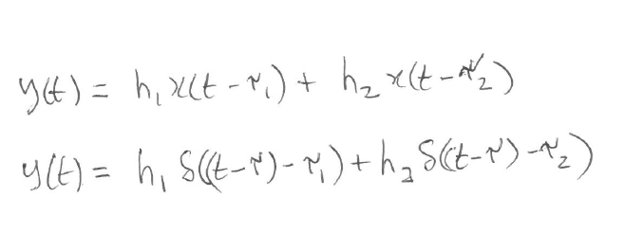
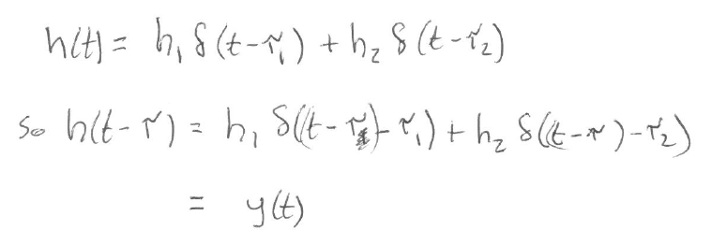
We can use mathematics to show that the previous picture is indeed correct.
Let the input signal be x(t)=δ(t-τ)
Remember the system equation:
So the output corresponding to this particular input x(t) is:
Recall the formula for h(t) for the two path channel is:
We conclude that the output y(t) is just h(t) delayed by τ seconds.
This means that the system is time invariant.

Slide 17
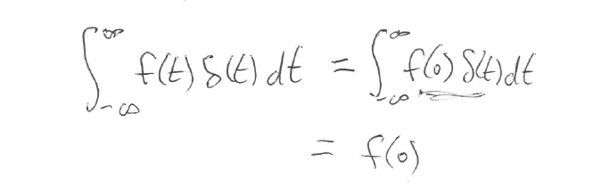
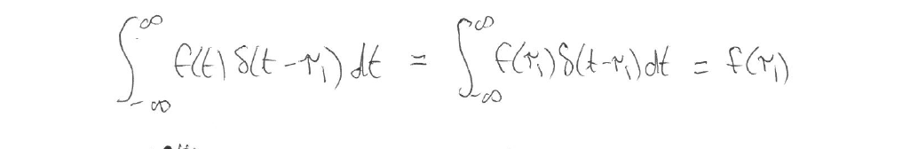
The Sifting Property of the δ-function
A very important property of the δ-function is the sifting property
This first equation says that we can use the unit δ-function to sift out the value of the signal f(t) at time t=0.
A more general version of the sifting property of a δ-function is the following:
This second equation says that if we multiply a signal f(t) by a unit impulse, with the impulse located at a particular time, say, t=τ₁, and we integrate the whole thing, we sift out the value of the signal f(t) at that particular time ie we sift out the value f(τ₁).
In other words, we can use the unit δ-function to sift out the value of the signal f(t) at any arbitrary time t=τ₁.

Slide 18
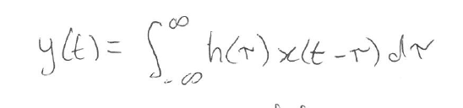
Convolution
Section 2.4 in Haykin and Van Veen, p 115; Section 2.2 in Oppenheim and Willsky p90
Convolution is an operation on two signals; it will be of fundamental importance to LTI Systems
If we have two signals h(t) and x(t) their convolution is the signal y(t) = h(t)*x(t).
The equation for convolution is :

Slide 19
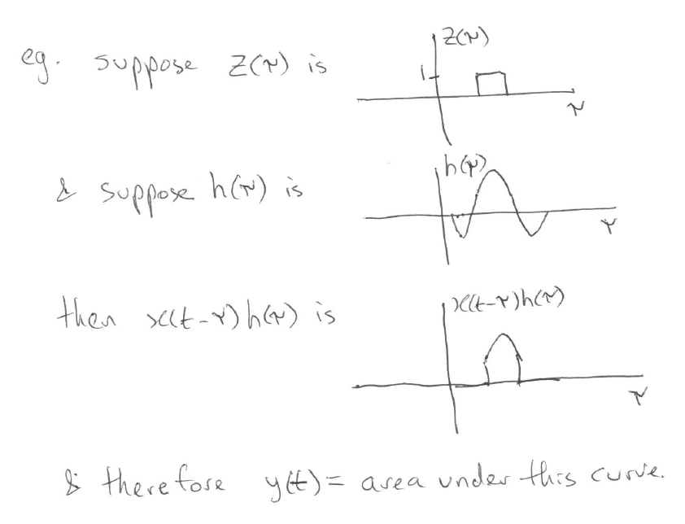
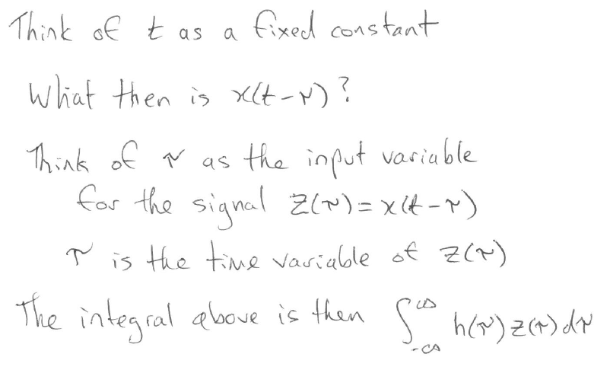
Convolution Equation Explained

Slide 20
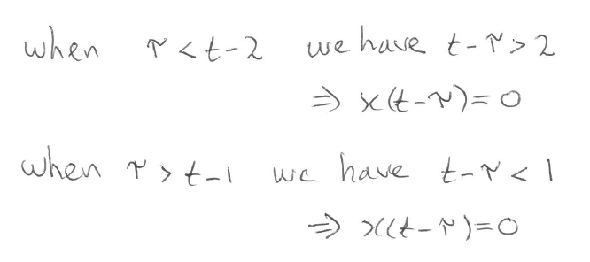
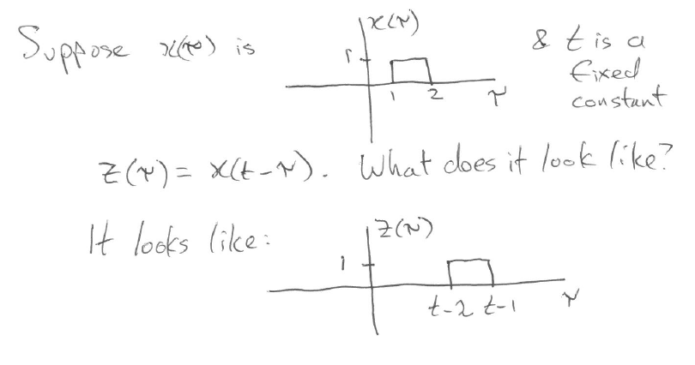
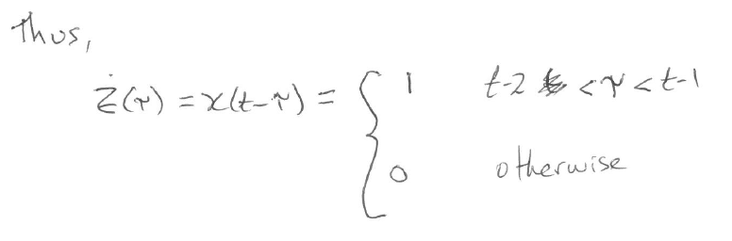
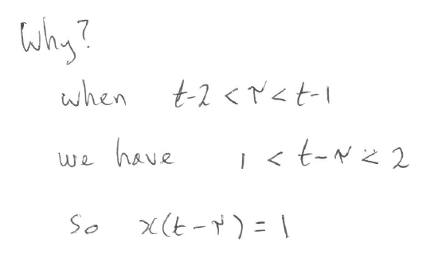

What does z($τ) look like?$

Slide 21
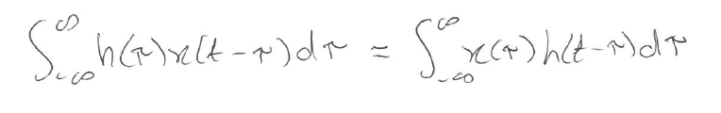
Convolution commutes; in other words, h(t)*x(t) = x(t)*h(t), which can be verified by showing:
This is an exercise for the diligent student (hint: do a change of variables in the integration)
The formula for convolution should trigger a memory.
Recall the radio channel with a continuum of paths.
This channel had the input-output equation given by:
In other words, y(t)=h(t)*x(t). Here h(τ ) is the channel gain of a path of delay τ
What is the impulse response of this channel?

Slide 22
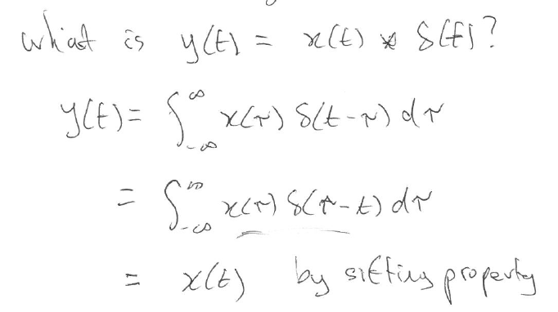
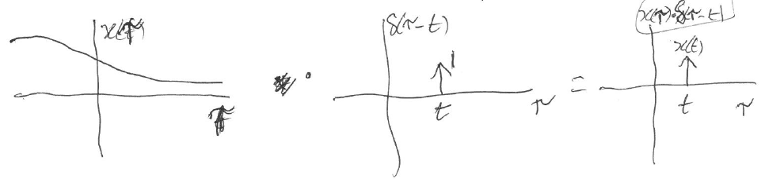
Convolution with a δ function
This shows that convolving a signal with the unit impulse doesn’t do anything to the signal. Its like multiplying a number by 1: no change to the number. Here, there is no change to the signal x(t).

Slide 23
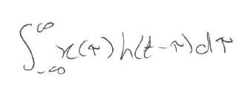
Radio Channel as a Convolution
Lets return to the radio channel with input-output equation:
and ask the question: What is the impulse response of this channel?
It will be the output, y(t), when the input is given by x(t)=δ(t), which is y(t)=h(t)* δ(t)
But by the above result (previous page) about convolution with a δ function, y(t)=h(t)* δ(t) = h(t)
We conclude that h(t) is in fact the impulse response of the channel given by
This equation says that the output of the channel is obtained by convolving the impulse response of the channel with the input signal
Since convolution commutes, we could equally say that the output of the channel is obtained by convolving the input signal with the impulse response of the channel, ie.
y(t) =

Slide 24
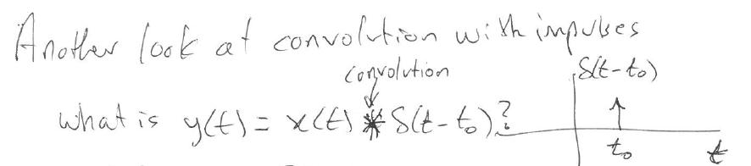
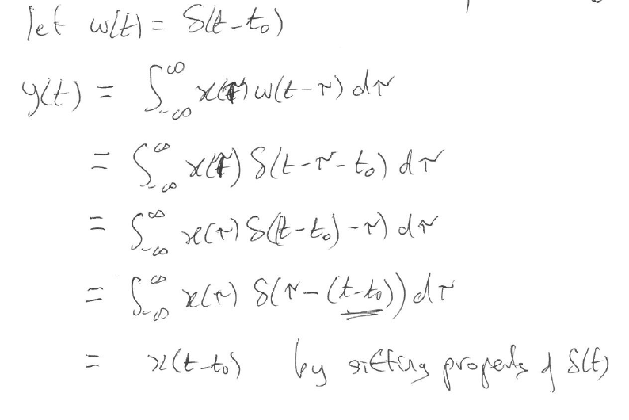
Convolution with a δ function
Here, we are looking at a shifted delta function, or, in other words, a delayed unit impulse (well, delayed if t₀ > 0).
The mathematics here shows that convolving a signal with an impulse located at a particular time, delays the signal by that amount of time, and that is all that it does.
This results includes the earlier result, which was the special case when the impulse happens at time t=0. Delaying a signal by 0 seconds doesn’t do anything to a signal.
The result on this page is more general, allowing the impulse to occur at an arbitrary time t₀ .

